Slide 1
Introduction to MongoDB
Instructor: Sriya Ivaturi

Slide 2
Introduction to MongoDB
Title: What is MongoDB?
  MongoDB is a NoSQL database — stores data in a flexible, non-relational way.
  Developed by MongoDB Inc., open-source and highly scalable.
  Designed for speed, flexibility, and handling large volumes of data.
  Often used in web apps, analytics, IoT, content management, and AI projects.
Title: Why use MongoDB?
  Handles unstructured / semi-structured data easily.
  No fixed schema → quick changes in data structure.
  Powerful query language similar to JSON.
  Scales horizontally with sharding.
Real-life analogy: Think of MongoDB as a big container where you can throw items of any shape and size, unlike a SQL table where every item must be the same shape.

Slide 3
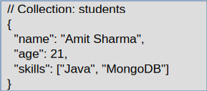
Documents and Collections
Title: The Core Building Blocks
  Document → The basic unit of data in MongoDB.
    Similar to a row in SQL, but richer and more flexible.
    Stored in BSON (Binary JSON) format internally.
  Collection → A group of related documents.
    Similar to a table in SQL.
    No strict rules that all documents must have the same fields.
Example:
Analogy: Documents are like files in a folder (collections). The folder holds similar documents, but each file can have different fields.

Slide 4
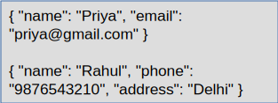
Schema-less Structure
Title: Freedom from Rigid Tables
  Schema-less = No predefined structure for data.
  Each document can have different fields, data types, and nesting levels.
  Ideal for rapid prototyping and apps where data changes frequently.
Example: Both can exist in the same collection:
Real-life analogy: Like a drawer where you can keep a pen, a notepad, or a snack — no rules saying all items must be the same.

Slide 5
JSON Format and Nesting
Title: Data Representation in MongoDB
  MongoDB uses JSON-like documents → easy to read and write.
  Supports nested documents and arrays.
  Nested structure = keeps related data together in one place, reducing joins.

Slide 6
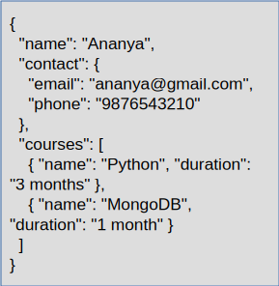
Example of a document
Benefit: All related info about a person is stored inside one document, no need to query multiple tables.

Slide 7
RDBMS vs MongoDB Analogies
Tables / Relations ➜ Collections
Rows / Tuples / Records ➜ Documents
Columns / Fields ➜ Keys / Fields
Primary Key ➜ _id Field
Example:
  RDBMS: (Row) → | id | name | city |
  MongoDB: (Document) → { "_id": 1, "name": "Alice", "city": "Delhi" }

Slide 8
Features Of MongoDB
Schema-less Structure
High Performance
Flexible Document Model
Horizontal Scalability (Sharding)
High Availability (Replication)
Powerful Query Language
Easy Integration
Aggregation & MapReduce
Security Features

Slide 9
High Performance
Feature:
  Fast read and write operations due to indexing and in-memory caching.
Example:
  Used by Uber and eBay for real-time data access.
Benefit:
  ✅ Supports high-traffic applications with low latency.

Slide 10
Flexible Document Model
Feature:
  Stores data as BSON documents (Binary JSON).
  Supports nested fields and arrays.
Example:
Benefit:
✅ Represents real-world data naturally and intuitively.
{
"student": "Alice",
"courses": ["DBMS", "AI"],
"address": { "city": "Mumbai", "pin": 400001 }
}

Slide 11
Horizontal Scalability (Sharding)
Feature:
  Distributes large data sets across multiple servers automatically.
Example:
  Data split into shards based on a key (like user_id).
  Each shard holds part of the collection.
Benefit:
  ✅ Supports massive datasets and global-scale applications.

Slide 12
High Availability (Replication)
Feature:
  MongoDB uses Replica Sets to maintain multiple copies of data.
  One primary node + multiple secondary nodes.
Example:
  If one server fails → another automatically becomes primary.
Benefit:
  ✅ Ensures data reliability and zero downtime.

Slide 13
Powerful Query Language
Feature:
  Supports rich queries, aggregation pipelines, and indexing.
Example:
  db.students.find({ marks: { $gt: 80 } })
Benefit:
  ✅ Can perform filtering, sorting, and data transformation easily.

Slide 14
Easy Integration with Applications
Feature:
  Works well with popular programming languages and frameworks.
Examples:
  Integrates with Node.js, Python, Java, and Spring Boot.
  Works smoothly with cloud platforms like AWS and Azure.
Benefit:
  ✅ Ideal for modern web, mobile, and cloud-based applications.

Slide 15
Security Features
Feature:
  Includes authentication, authorization, and encryption.
Example:
  Role-based access control (RBAC)
  SSL/TLS encryption for data in transit.
Benefit:
  ✅ Protects sensitive data from unauthorized access.

Slide 16
Summary Of Features
🧱 Schema-less Structure – No fixed schema; flexible document storage.
⚡ High Performance – Fast read/write operations with indexing and caching.
📊 Flexible Document Model – Stores data in BSON (JSON-like) format with nested fields.
🌐 Horizontal Scalability (Sharding) – Distributes data across multiple servers.
🔁 High Availability (Replication) – Ensures data reliability with replica sets.
🔍 Powerful Query Language – Supports rich queries and aggregation pipelines.
☁️ Easy Integration – Works seamlessly with popular languages and cloud platforms.
🧩 Aggregation & MapReduce – Enables advanced analytics and data processing.
🔒 Security Features – Authentication, authorization, and encryption for data protection.

